Slide 1
Workshop on
Clinical Outcome Assessments (COAs) in Cancer clinical trials
April 26, 2016  Silver Spring, MD
Co-sponsored by

Slide 2
Session 2
Using Multiple Instruments to Create a Comprehensive PRO Assessment
Strategy in Cancer Trials
Workshop on Clinical Outcome Assessments (COAs) in Cancer clinical trials
April 26, 2016  Silver Spring, MD
Co-sponsored by

Slide 3
Disclaimer
The views and opinions expressed in the following slides are those of the individual presenters and should not be attributed to their respective organizations/companies, the U.S. Food and Drug Administration or the Critical Path Institute.
These slides are the intellectual property of the individual presenters and are protected under the copyright laws of the United States of America and other countries. Used by permission. All rights reserved. All trademarks are the property of their respective owners.

Slide 4
Session Participants
Chair
  Stephen Joel Coons, PhD – C-Path
Presenters
  Paul G. Kluetz, MD - FDA
  Patty Spears – Cancer Information and Support Network
  Alicyn Campbell, MPH – Genentech
  Charles S. Cleeland, PhD – M.D. Anderson Cancer Center
  Sandra A. Mitchell, PhD – NCI, NIH
  Andrew Bottomley, PhD – EORTC
  David Cella, PhD – Northwestern University Feinberg School of Medicine
Panelists
  Elektra Papadopoulos, MD, MPH – FDA
  Jeff A. Sloan, PhD – Mayo Clinic

Slide 5
Incorporation of Multiple PRO Instruments in Clinical Trials
Paul G. Kluetz
Office of Hematology and Oncology Products
U.S. Food and Drug Administration

Slide 6
This talk represents current thinking in an evolving area of scientific and health care policy
The views expressed do not necessarily reflect the official position of the U.S. Food and Drug Administration

Slide 7
Session 1 Review: FDA Use of PRO Data
FDA reviews all submitted PRO data as important supportive data in the overall benefit:risk assessment
  All PRO data should be assessed rigorously with this in mind
  Proximal symptom/function is the current focus for product labeling
  Safety/tolerability relevant objective for PRO measures in many contexts
To be considered for product labeling:
  PRO assessments must be well-defined and reliable
  Claim of treatment benefit should be tested in statistical hierarchy
  Goal: Provide informative, interpretable patient-centered data to further inform the safety and efficacy of an anti-cancer therapy

Slide 8
Opportunities and Challenges for PRO Measurement in Contemporary Cancer Trials
Sustained commitment to research in biology, immunology and genetics = unprecedented treatment effects
  FDA programs used to expedite deliver of cancer therapies to patients
  More single arm trial submissions
  Randomized trials commonly open-label
Multiple different mechanistic classes of agents = more diverse symptomatic side effect profiles
Opportunity: Expanding options for PRO measurement

Slide 9
Expanding PRO Toolbox
FACIT Measurement System:
  http://www.facit.org/FACITOrg/Questionnaires
  FACT-G, Cancer Specific Measures, Cancer Specific Symptom Indexes, Treatment Specific Measures
EORTC Quality of Life Questionnaires:
  http://groups.eortc.be/qol/
  EORTC-QLQC30 and Disease Specific Modules
MD Anderson Symptom Inventory (MDASI)
  https://www.mdanderson.org/education-and-research
  MDASI Core Symptom Inventory, Disease Modules, BPI-SF, BFI-SF
PROMIS® Tools
  http://www.nihpromis.org
  Measures of physical, mental and social well-being and global health
Patient-Reported Outcome version of CTCAE (PRO-CTCAE)
  http://healthcaredelivery.cancer.gov/pro-ctcae
  Item library of symptomatic adverse events
Many other disease specific and symptom specific measures that are completed or in development

Slide 10
Assessment of Symptomatic Adverse Events
The assessment of safety and tolerability is important across clinical trial contexts, including single arm trials
There is interest in exploring the NCI PRO-CTCAE symptomatic adverse event item library
  Systematically incorporate the patient voice into safety assessments
  Complement clinician reported safety findings

Slide 11
Patient-Reported Outcomes version of the Common Terminology Criteria for Adverse Events (PRO-CTCAE)
Strengths
  Patient-reported (Standard oncology safety assessment is Clinician Reported)
  Systematically and rigorously developed
  Standardized: provides a standard item library and platform
  Flexible: Select a subset of the 78 items to create a study-specific survey
  Complements existing safety evaluation (CTCAE)
Early in Implementation: Much Work to be Done
  Translations and Cultural Adaptations
  Scoring
  Unbiased Item Selection
  Most informative method to analyze and present data
For more information and permission to use PRO-CTCAE, visit: http://healthcaredelivery.cancer.gov/pro-ctcae/
Notes:
One solution to this issue is the use of an item bank such as the PRO-CTCAE which can add flexibility to the PRO strategy by targeting those relevant and important adverse events based on the MOA of the drugs under study.
The PRO-CTCAE has strengths and limitations and there is still much work to be done.
Strengths:
Work To be Done:
We recognized that this instrument is only just now becoming more widely available and that there is frustration surrounding access and guidance on how to integrate it into larger commercial trials. We are working with the NCI and many stakeholders to address some of these issues and understand that much work needs to be done.

Slide 12
What is the Standard PRO Assessment Strategy?
For registration trials, we typically receive a 27-30 item Health-Related Quality of Life (HRQoL) instrument
A Disease Module is typically added
Current Item Burden: In general, approximately 40-50 questions are asked of patients at various assessment frequencies.
EQ-5D commonly submitted (5 items and a visual analogue scale)

Slide 13
Respondent Burden
Assessment frequencies must be frequent enough (especially early in treatment) for the clinical context
  In the advanced/metastatic cancer setting, patients may be off-study for progression at 2-3 months
There is a concern for increased respondent burden and duplication with the integration of additional instruments to standard PRO assessment approaches

Slide 14
Adding Tools to the Standard PRO Assessment Strategy- PRO-CTCAE
Minor duplication occurs with common strategy of combining HRQoL assessments, disease module, and EQ-5D
Addition of PRO-CTCAE symptomatic adverse event assessment can add 20-30+ additional questions
  May be at higher assessment frequency than the remainder of PRO assessments in a trial
  Likely additional duplication with treatment symptom items from disease modules and HRQoL instruments

Slide 15
Adding Tools to the Standard PRO Assessment Strategy- Other Measures of Interest
Burden when adding new tools is not unique to PRO-CTCAE. Trial objectives may call for a more detailed assessment of other patient-reported symptom and function measures
  Pain
  Fatigue
  Physical Function
  Other symptom or functional outcome assessments unique to the disease and therapeutic context (e.g. swallowing in esophageal cancer, cognitive function in neuro-oncology)

Slide 16
Session 2 Overview:
PRO objectives are different depending on the type of trial. We aren’t looking to identify a specific maximum number of questions per trial…
Session 2 is about opportunities and challenges associated with integrating multiple PRO assessments in cancer trials
Goal of a PRO assessment strategy: Informative, relevant and rigorous patient-centered data while managing burden

Slide 17
Incorporation of Multiple PRO
Tools in a Single Trial:
Rigorous PRO data describing the patient experience is an expectation for multiple stakeholders who make treatment, regulatory and health policy decisions
Discuss the issue of respondent burden
  What are considerations for addressing respondent burden?
Discuss the issue of duplication
  What are considerations for addressing duplication?

Slide 18
A Patient’s Perspective on PRO Assessment
Patty Spears
Cancer Patient Research Advocate
Cancer Information & Support Network
Raleigh, NC
@paspears88

Slide 19
Why PROs?
PROs Consider:
Not only WHAT IS THE MATTER with the patient
But also WHAT MATTERS to the patient
~~Sandra Finestone
“A PRO is any report of the status of a patient’s health condition that comes directly from the patient, without interpretation of the patient’s response by a clinician or anyone else.”
Assessing harms and benefits are very subjective and needs to be done consistently and reliably to actually predict benefits and harms that ARE IMPORTANT to patients.

Slide 20

Aid in Decision Making: Benefits vs. Harms
Once a drug is approved, patients are faced with treatment decisions.
Decision making on the part of the physician and patient is important and very complex.
What is necessary to make that decision?
  BENEFITS
    What benefits are being measured and are they important to patients?
  HARMS
  What harms are being measured and are they important to patients?
  .
Harms
Benefits
The best decision is made when everyone is fully informed of the actual benefits and harms that are important to patients!

Slide 21
The Clinical Trial Landscape is Changing
Patients are more involved in research, in clinical trials and in their own healthcare.
Patients want to have a voice.
Patients need the information from other patients on trials to make Patient Informed Decisions about their treatment.
The process to approve drugs is changing – accelerated approval, breakthrough designations.
Precision Medicine Initiative – it’s changing the way we do trials.

Slide 22
So, what’s the problem?
Historically:
  QOL questionnaires have been around since the ‘70s
  HR-QOL questionnaires have been around since the ‘90s
  Short forms have been developed for diseases (FACT-B, FACT-P, etc)
  Specific forms for certain side effects have been developed (Anxiety, Depression, etc)
Why is it still so challenging?

Slide 23
Challenges
  One size fits all approach (chemotherapy vs targeted therapy)
  Although health-related focused, the questionnaire is still very broad
  New short forms are added on top of each other
  Measuring items not associated DIRECTLY with the patient experience as it relates to disease and treatment
  Not a primary objective and not often a secondary objective
  Analysis and reporting is not done at the same time as the efficacy clinical trial results (later and different journals)
  Information of HR-QOL is not getting back to the patient and and is not aiding patients decision-making.

Slide 24
What do patients think are barriers?
Redundancy
  Being asked the same question over and over
  Redundant questions irritate patients
Complexity
  Vague or unclear questions
  The answer isn’t there and no write in options
  Not fully understanding the question
Time
  The time it takes to fill them out – too long
  The pressure they feel to do it quickly - rushed
  Too many questions

Slide 25
What do patients think will help?
What is being asked is important
  Asking about what matters to them
  Relevant questions to what they are experiencing
Knowing why the questions are being asked
  Knowing what the results are being used for
  Relevance to them and other patients
Feedback is important
  That their responses are being used in their personal care
  Being informed about the results and how they were used
Length/Time matters!
  The number of questions and/or the time required
  Less questions can be asked more often, more questions less often

Slide 26
What changes are needed?
Now
Future
Used in phase 3 trials
Analyzed separate from efficacy and published at different times
Information is not shared with patients
Instrument validation
Combination of multiple instruments
Global HR-QOL
Use in early phase trials (1,2 and 3)
Analyzed along with efficacy and published together
Information is shared with public and patients
Item (question) validation
Combination of specific items
Targeted measurements

Slide 27
How do you effectively collect PRO data in trials?
Start Early - collecting PRO data in early trials (Phase I and II) to better inform the collection of PROs in larger later trials (Phase III)
Develop targeted (precision) PRO assessments for ALL trials
  Asks patients to report what matters to them
  Make PRO measures acceptable to patients to complete
  Make PRO measures an important part of the trial with well-defined purpose and use
  Make the PRO endpoints meaningful to patients
  Make the PRO information available to patients
Patient Informed PRO Measures - ASKING:
The Right Question ~ at The Right Time ~ in The Right Way

Slide 28
How does this happen?
Rigor in development and incorporation of PRO measures in trials
Include patients and other stakeholders in discussions about relevance, timing and construction of PRO measures
Process of PRO inclusion during trial development
  What is the Treatment (chemo, immuno, biological)?
  What is the Disease (Stage, type)?
  What is the Endpoint?
    What measures are needed?
    How often will they be collected?
    When will they be analyzed?
Patient Informed PRO Measures - ASKING:
The Right Question ~ at The Right Time ~ in The Right Way

Slide 29
Potential Benefits - Gains
Less missing data (potentially)
  Patients more likely to fill out the questionnaires that are relevant, take less time and they understand their importance.
Relevant information for informed decision-making
  Physicians and patients will have access to the results to make a more informed decision.
Value will be added
  New agents can be approved based upon improving how a patient feels and functions in addition to efficacy and safety.
Patient Informed PRO Measures - ASKING:
The Right Question ~ at The Right Time ~ in The Right Way

Slide 30
An Industry Example of Instrument Modification
Alicyn Campbell, MPH
Global Head, Patient-Centered Outcomes Research for Oncology
Genentech, a Member of the Roche Group
Workshop on Clinical Outcome Assessments (COAs) in Cancer clinical trials
April 26, 2016  Silver Spring, MD
Co-sponsored by

Slide 31
Disclosures
I am currently an employee of Genentech, a Member of the Roche Group
The opinions and thoughts expressed in this presentation are my own and do not reflect nor represent those of F. Hoffmann-La Roche AG, nor of Genentech, a Member of the Roche Group

Slide 32
Problem Statement
Tool modification to increase precision on concepts assessed (e.g. removing items that are not relevant for the target population or endpoint) and minimize responder burden is becoming increasingly common.
How can modification minimize burden and duplication when using multiple instruments?
What is an example of an instrument modification that has been done?

Slide 33
Rationale for Modifying Instruments
Sponsors need to create endpoints to assess outcomes of interest that demonstrate clinical benefit
Once patient-relevant concepts of interest are identified, sponsors are often limited by:
  Trial timelines (frequent lack of Ph2 in Oncology)
  Tools available
  Study design
  Differing evidence requirements of global stakeholders
Notes:
Focused on 3 core concepts: alleviation of tumor burden, treatment burden, physical functioning and interference w ADL: functional status.
Design: single arm, assessment schedule, doublet and triplewt therapies

Slide 34
Modification Example from Early Breast Cancer (EBC)

Slide 35
Treatment Burden and Information Gaps in EBC
Treatment-related symptoms define the patient experience: 90% of EBC patients are asymptomatic at diagnosis¹
Patients report the information they receive regarding experience and duration of treatment-related symptoms is inadequate²
Currently available therapies may have negative impact on patients’ ability to function and conduct activities of daily living^{3,4}, despite reducing the risk of recurrence and death
EBC Treatment
Symptom Frequency
Treatment
Burden
Impact
Symptom Severity
1. Ryerson et al. Cancer Causes Control. 2015; 2. PDUFA V Breast Cancer Meeting Report, 29 September 2015
3. Campbell et al. Clin Cancer Res. 2013; 4. Petersen et al., Cancer Research 2015

Slide 36
Collaboration with EBC Patients to Identify Measurement Concepts
Endpoint workshop conducted with eight breast cancer patient advocates¹
Reviewed the study design and participated in open-ended concept elicitation to identify:
  Key concepts and symptoms for patients undergoing neo(adjuvant) breast cancer therapy
  Functional impairments
  Other distressing aspects of disease for EBC patients
Follow-up qualitative research conducted²
Impact: Patient-relevant concepts identified to inform trial endpoints and future instrument development
1. Campbell et al. Clin Cancer Res. 2013; 2. Petersen et al., Cancer Research 2015

Slide 37
Research Supports Adapting Existing PRO Measure
Reviewed currently available tools for coverage of key patient identified measurement concepts: treatment-related symptoms and impacts (i.e., physical function)
Recommendation: Adapt the EORTC QLQ-C30 and BR23
  Modified the QLQ-BR23 in consultation with the EORTC for use in 4 neo-adjuvant and adjuvant studies
  Removed items 47−53 assessing symptoms and side effects experienced only in Metastatic Breast Cancer
  Inclusion of peripheral neuropathy and skin problems (2) items from the EORTC Item Bank Approved by EORTC Executive Committee
1. Campbell et al. J Clin Onc. 2013; 2. Petersen et al., publication pending; 3. Ryerson et al. Cancer Causes Control. 2015
Notes:
Reviewed currently available tools for coverage of key measurement concepts
Research and timelines supported adaption of existing metastatic breast cancer PRO measure
Breast cancer Oncologists
(addreHER2, ER/endocrine, and chemo sx)

Slide 38




Steps to Ensure Patient-Relevant Trial Endpoints^{1,2}
Review of the literature / measures
    Qualitative interviews with \
    EBC patients
    / concept saturation
    Analyze patient feedback and consult with EORTC on adaptation for EBC
2012
2014
    Advocate focus groups (former breast cancer patients) to identify concepts
    Inclusion in Ph3 EBC studies
1. Campbell et al. J Clin Oncology 2013; 2. Petersen et al., publication pending

Slide 39
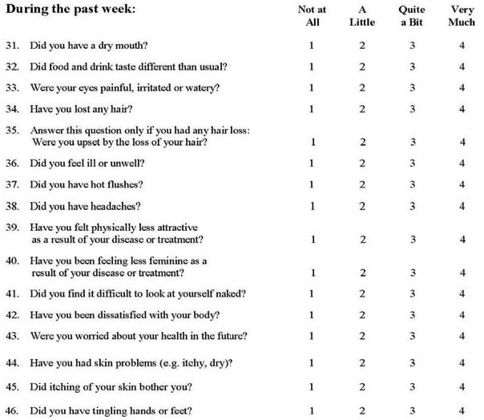
Modified
Measure

Slide 40
Analysis and Psychometric Activities
The EORTC QLQ-C30, BR23, and additional single item symptoms scales from the item bank scored according to their published guidelines¹
  Single items to be assessed by frequency of response option
Analysis to be performed on the modified BR23 in parallel with the final data analysis to confirm the psychometric properties of the instrument
  Pre-specified in the protocol and statistical analysis plan
By using validated single items, translations were available for the composite measure, enabling use in global Ph3 trials
1. Fayers et al. EORTC 2001

Slide 41
Conclusions
Yes you can!
  Seek patient input
  Construct a custom, patient-relevant endpoint
  Remove items not relevant to the patient population under study
  Meet tight (~12 weeks) timelines in a global trial
  Differentiate clinical benefit

Slide 42
Considerations in Addressing Respondent Burden
Charles S. Cleeland, PhD
Sandra A. Mitchell, PhD
Andrew Bottomley, PhD
David Cella, PhD
Workshop on Clinical Outcome Assessments (COAs) in Cancer clinical trials
April 26, 2016  Silver Spring, MD
Co-sponsored by

Slide 43

In the Beginning…
Deployment of PRO measures in Early Drug Development: Modification of the MD Anderson Symptom Inventory
Charles Cleeland, Lori Williams, Tito Mendoza, Qiuling Shi,
Xin Shelley Wang
Department of Symptom Research, MD Anderson Cancer Center

Slide 44
Approach – Developing “Fit for Purpose”
What could be expected of the investigational agent?
  Improvement or stabilization of disease-related symptoms or interference with functioning
  Lengthening of time to symptom deterioration
  Improvement in tolerability
How do we begin establishing reasonable PRO endpoints for the clinical trial?
  Literature review
  Patient interviews
  Feedback from standard of care and Phase I dosing trials
Maximize patient and clinician input
Use what we know – “incremental validity”

Slide 45
Context of Use for Item Selection/Creation
Target populations:
Patients with the trial’s disease and stage undergoing standard of care
Patients with the target disease or other cancers receiving the agent (or combination) in dosing and extension trials

Slide 46
Modification Process
Qualitative interviews for symptom identification and naming – establish content validity
Comparison of symptoms between groups for item attribution
Expert panel (patients, caregivers, clinicians) review for symptom relevance, item reduction
Cognitively debrief final items – item modification
Administer to validation sample
Elimination of low-yield items
Establish psychometric properties and sensitivity
Williams et al. Clin Investigation (Lond), 2013: Williams et al. J Pain Symptom Manag, 2013.

Slide 47
Example of Development: MDASI-OC
MDASI Core Items
Symptom Items
Fatigue/tiredness
Nausea
Pain
Vomiting
Sadness
Distress (emotional)
Difficulty remembering
Numbness/tingling
Lack of appetite
Shortness of breath
Disturbed sleep
Drowsiness
Dry mouth
Interference items
General activity
Mood
Work
Relations with others
Walking
Enjoyment of life

Slide 48
Candidate Items for MDASI-OC
Abdominal Pain
Fullness/bloating
Constipation
Problem paying attention
Back pain
Leg cramps or leg muscle pain
Urinary frequency/urgency *
Pain or burning with urination*
* Clinician suggested
Williams et al, J Pain Symptom Manag, 2013; Sailors et al. Gynecol Oncol, 2013.

Slide 49
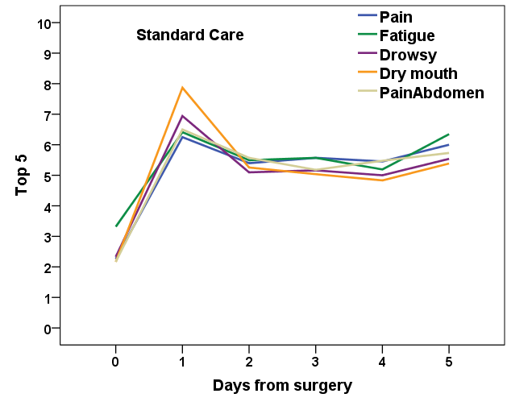
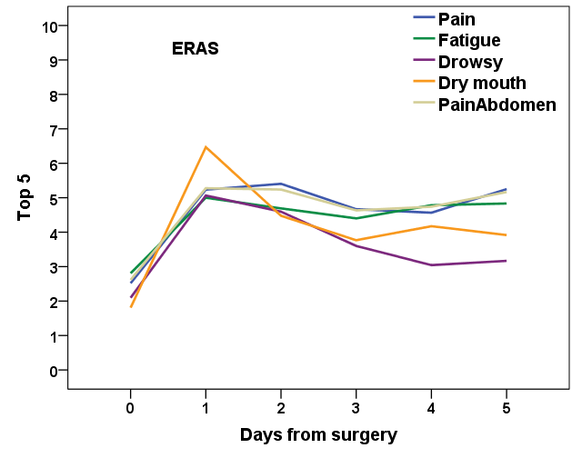
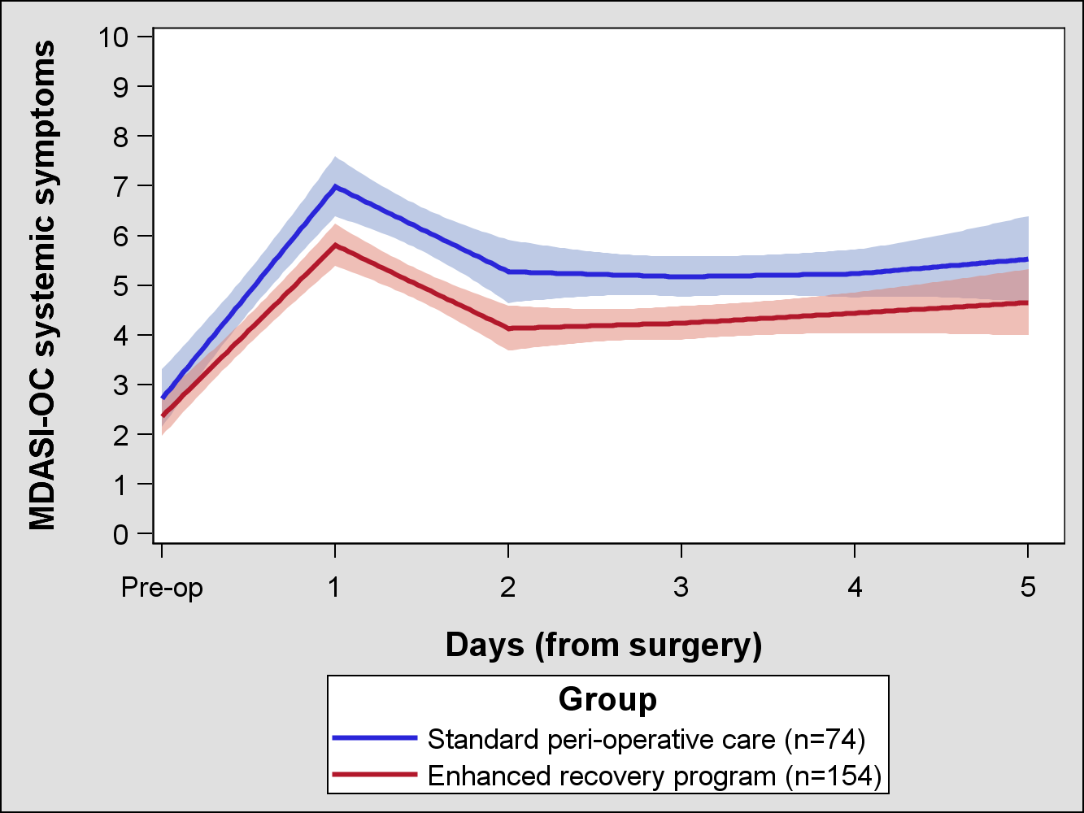
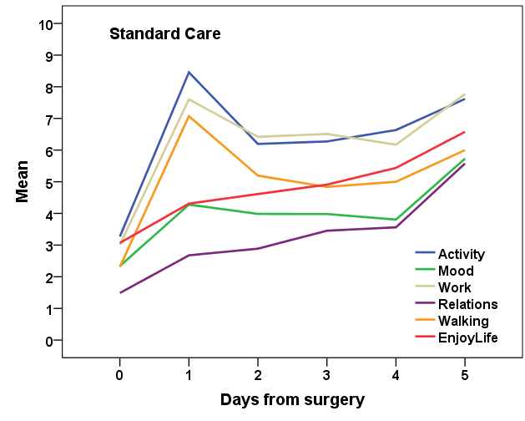
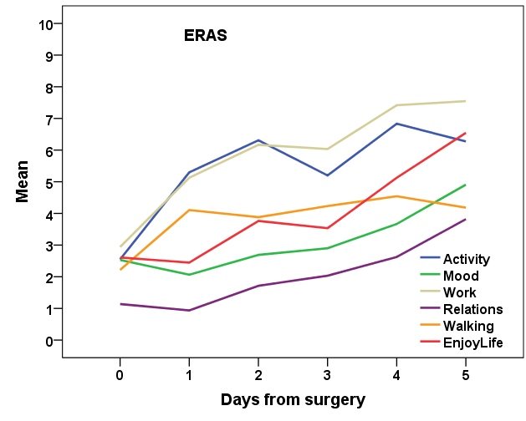
Perioperative Symptom Burden from Laparotomy for GYN Cancer: MDASI-OC
Top Symptom Items
Interference Items
Average score of systemic symptoms: fatigue, dry mouth, drowsiness

Slide 50
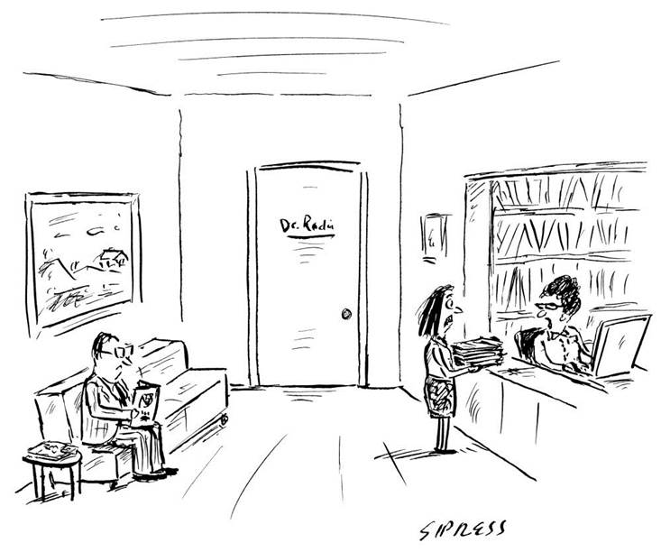
“Your appointment’s been cancelled.
You took too long filling out those forms.”

Slide 51

Considerations In Addressing Respondent Burden and PRO Item/Construct Overlap in Cancer Clinical Trials
Sandra A. Mitchell, PhD, CRNP
Research Scientist and Program Director
NCI Scientific Director, PRO-CTCAE
Outcomes Research Branch
Division of Cancer Control and Population Sciences
National Cancer Institute
Rockville, MD
mitchlls@mail.nih.gov

Slide 52



Is there a burden to respondents and study staff associated with inclusion of PROs in cancer clinical trials?
  Little empiric knowledge of respondent or administrative burden
  Patient perceptions of burden are individual-, context- and measure-specific:
    Individual: Health status, reading speed, visual acuity, dexterity, understanding of why providing the information is important
    Context: Frequency, convenience, timing
    Measure: Time to complete, ease of cognitive task, emotional distress/novelty-engagement
  Many researchers and decision-makers value this information
    Can add to trial complexity if not accommodated thoughtfully into clinical workflow
    Handled as any other protocol-related evaluation

Slide 53



In the Contemporary PRO Context, Burden Is Increasingly Addressed Through Technology
  Electronic administration reduces the number of items that must be asked of patients
    Conditional branching
    Computer adaptive testing
  Technology has enabled data collection to be more efficient, customized, mobile, and responsive
    Smart phone/hand-held devices/Interactive Voice Response (IVRS) for data collection
    Customize time of day for assessment, text size on screen, and mode of administration
    Reminders to patients and staff for missed surveys
    Eliminate need for data entry (and the associated errors)
    Mobile devices may improve engagement in data collection and convenience

Slide 54
What do we really mean when we say that there is duplication or overlap?
Prima facie evaluation may suggest overlap
BUT important to consider:
  Construct (anxiety vs. worry)
  Attribute/dimension being assessed(e.g. symptom severity vs. interference vs. bother)
  Recall period (past day, past week, past month)
  Response scale (Likert, LASA? 4, 5 or 10 point?)
Duplicative items may be an essential component of a scale
  Bodily pain (2 items) and vigor (1 item) are part of SF-36 Physical Component Summary (PCS) Score, and are required for a summary score to be calculated
  There is minor overlap from a conceptual perspective with a measure of pain or fatigue
  Such redundancy is minor from a practical perspective and must be preserved for a valid interpretation of SF-36 PCS score

Slide 55
Why not just address any redundancy by omitting a ‘duplicative’ item from a scale or index? Isn’t that fundamentally what an item library or item bank does?
Alter measurement properties
  Reliability, validity, responsiveness
  Change established factor structure
Lose the ability to compare sample values with other population values/historical controls
Shift scoring, particularly if it is a weighted scale or a summated index
For example with an index, a high score on one indicator may compensate for a low score on another; removing one or more items (particularly if that item reflects a rare or common symptom) can significantly shift score interpretation
Item library is a collection of items, some of which may be nested or grouped
Item bank is a repository of items along with information about their alignment or calibration against a standard, allowing for scores to be expressed on a common psychometric scale

Slide 56

Why not just create a ‘customized’ PRO strategy by selecting relevant single items from validated measures?
Single items are valuable in measuring narrow constructs or providing global assessments
Single items may be useful for screening or as part of a branching strategy
Lower reliability and restricted range for responsiveness to change
Ceiling and floor effects (eg. single item to measure fatigue severity may provide no range for worsening in respondents rating fatigue as severe or very severe at baseline)
Collection of single items also invites problems of multiplicity
Summation of single items can be less than informative and may obscure change over time
  High score on one indicator may compensate for a low score on another

Slide 57
How much symptom domain overlap exists in among PRO measures commonly used in oncology trials?
SF-36
Fatigue
Pain
Mood
PROMIS-29
Fatigue
Pain
Depression
Anxiety
Insomnia
FACT-G
Fatigue
Nausea
Pain
Depression
Anxiety
Insomnia
EORTC-QLQ C-30
Fatigue
Pain
Depression
Anxiety
Insomnia
Shortness of breath
Anorexia
Nausea
Vomiting
Constipation
Diarrhea
Concentration problems
Memory problems
MD Anderson Symptom Inventory
Fatigue
Pain
Depression
Insomnia
Shortness of breath
Anorexia
Nausea
Vomiting
Concentration problems
Numbness
Dry mouth
Distress
Drowsiness
Global Symptom Interference
Estimated duplication (<11 items) created by use of PRO-CTCAE weekly along with any of these measures
<11 items
<11 items
<11 items
<11 items

Slide 58

Key Points
Estimated additional time burden introduced by overlap is estimated to be 2 minutes or less per HRQL or disease-specific symptom measure
  Given that many trials include 4-6 post-baseline assessments for an HRQL endpoint, use of a measure of disease-related symptoms or HRQL together with weekly PRO-CTCAE reporting, adds an estimated 15 minutes or less of additional burden attributable to ‘overlap’, across the course of a trial
Strive for a parsimonious measurement strategy
  Hypothesis driven and focused on a specific set of constructs (e.g. symptomatic toxicity, physical function, disease-related symptoms, )
  Timing of assessments based on clinical knowledge of the anticipated treatment effects and tumor response

Slide 59
Key Points
CAT and IRT-based measurement allows for parsimony and precision and reduces non-informative overlap
Pulling apart established measures by selecting a subset of items has the potential to set our field back:
  Lose the established measurement properties of the scale/subscale
  Chance ceiling or floor effects
  Abandon interpretive norms and minimally important difference
  Invite challenges of dealing with multiplicity
  Attract the interpretive difficulties associated with aggregated (or summed scoring)
Single items have an important role in screening, in well-validated global impression items, and as part of a conditional branching strategy
Measures can be tailored over time through rigorous empiric methods

Slide 60
Reducing patient burden issues in cancer clinical trials: An EORTC perspective
Andrew Bottomley, PhD.
Assistant Director,
Head Quality of Life Department

Slide 61
What is the EORTC experience in tool development?
1. Questionnaire development
In older trials, prior to 1980, burden caused by filling in QOL tools was a major problem in EORTC trials, which sometimes failed for this reason (e.g. Diary!).
Nowadays this is a very rare problem.
  EORTC AML 13 trial had a compliance of 40% at baseline
Since 1990, EORTC instrument guidelines¹ and clinical trials manuals² stress the fact that we respect patients views. We do our best to never burden them and always make efforts to reduce burden.
Developing new tools takes over 6 years and involves 1000s of patients. Asking for redundant items over the years is critical and a major part
2. Trial development and designing
EORTC trials with QOL (over 160) usually have 2 tools plus EQ5D. Rarely more.
EORTC found no difference when patients complete 1, 2 or 3 (EQ5D) tools
Are we sure patient burden is as much of a challenge as we think?
Young T, et al Guidelines for assessing quality of life in clinical trials. 2nd ed. Brussels: EORTC Quality of Life Study Group Publications; 2002. ISBN 2-930064-27-7. 2 Johnson C, et al. Guidelines for developing Quality of Life Questionnaires. 4rd ed. Brussels: EORTC Publications; June 2011. ISBN 978-2-930064-413

Slide 62
Challenges of multiple static tools
EORTC is aware that sometimes not all items are valid in the whole trial population, as static tools are developed for a broad ranges of patients within a disease (e.g. Lung covers SCLC and NSCL).
Not all patients are the same, all are different!
Examples where items in EORTC tools may be less important to some patients:-
Patient specific
Does your hair loss bother you? - How is this relevant to a bald man?
Unable to walk up a flight of stairs? - How is this relevant for people using elevators?
Population/ design specific
Nausea and vomiting - How is this relevant to a cancer survivor off treatment one year post chemo?
Diarrhea - How is this relevant to an early breast cancer patient 12 months post therapy, assessed every year for 5 years?
Fear of recurrence when patients in a trial of recurrent disease

Slide 63
How does EORTC cope with this in trials, as all trials are different with new therapies or novel combinations?
We accept that there are limitations with static tools: newer IT based tools can be a future solution.
However, we are not currently running with new IT tools, or will be for the next 5 years in any standardized way. So what do we do?
Accept the limitations of static tools (as we have for decades), but also recognize advantages (e.g. can be done piece meal: when wanted, without IT such as PC, internet, WIFI, electrify or batter power, telephone (IVR)
Design trials with attention to over burden (only critical tools) and key assessments time points
Understand that patients (at least in the EU) rarely complain about too many tools.
  One patient per trial, X 12 assessment points, x 15 mins = 3 hours effort (often in a clinic waiting).
  In the perspective of a patient is 3 hours over a trial of 2-3 years so much?
  Would they rate hospital parking, waiting for HCP, waiting for treatment maybe all more of an issue than spending 15 minutes in a waiting rooms filling in a measure?
Evidence that patients like to complete relevant QOL measures
Solutions are not always to cut down tools to the endpoints of scales that you think are critical, as you may miss points. Eg. We hope we select the best 5-6 scales, but even if we rely on data from phase 1-2 trials and on clinical judgments, we cannot always predict correctly.
Notes:
Andrew to give the TMZ examples and report the 2005 paper as an example.

Slide 64
What can help us address patient burden concerns? An EORTC approach
A good design
  Don’t include too many tools.
  Try not to over assess patients every month.
    If you have too many questions ethics committees, clinicians and patients will object and this will lead to problems.
  Be clear than some good quality data is important.
  Push for making the investigators aware: kick off meetings, training, newsletter, awards for cakes, manning and shaming, education, funding compliance. Trial motivator.
Explain in the informed consent that some questions may seem less relevant to you but could be important for patients who may have these issues, and explain that some items may overlap, but this is so we can have a detailed picture of the issues which we are not sure about.
We have several trials in EORTC where we did not have a scale or full tools, so we used the EORTC item bank to select items, to be added as a check list (e.g. Muscatus in a bladder trial?).
  Our item bank has 1500 items and all translation, so it is an easy tool, free for all academics!

Slide 65
The Future
Over the next 10 years, newer IT based tools will help refine measurement practices in RCTs.
However, patients may want all options including pencil and paper, and while many patients like ePRO, some studies show that in less economically advanced rural areas in EU patients prefer pen and paper.
Keep the challenge of patient burden in perspective.
  Patient burden is a challenge, and may grow as demand from users increases, but remember patients are helpful, will be happy to help: after all, in EORTC experiences, patient burden rarely emerges as a problem

Slide 66
Considerations in Addressing Respondent Burden
David Cella, PhD
Chair, Department of Medical Social Science, Northwestern Feinberg School of Medicine

Slide 67
Rules of thumb
For the typical oncology clinical trial:
4-6 assessments over 1-2 years
Fewer than 50 items per assessment
Less than 15 minutes per assessment
For every overburdened patient there are 10 grateful ones

Slide 69
Panel Discussion
Leveraging Existing and Emerging Tools to Optimize PRO Assessment Strategies in Cancer Trials

Slide 70
Session Participants
Chair
  Stephen Joel Coons, PhD – C-Path
Presenters
  Paul G. Kluetz, MD - FDA
  Patty Spears – Cancer Information and Support Network
  Alicyn Campbell, MPH – Genentech
  Charles S. Cleeland, PhD – M.D. Anderson Cancer Center
  Sandra A. Mitchell, PhD – NCI, NIH
  Andrew Bottomley, PhD – EORTC
  David Cella, PhD – Northwestern University Feinberg School of Medicine
Panelists
  Elektra Papadopoulos, MD, MPH – FDA
  Jeff A. Sloan, PhD – Mayo Clinic

Slide 71
Workshop on
Clinical Outcome Assessments (COAs) in Cancer clinical trials
April 26, 2016  Silver Spring, MD
Co-sponsored by

